Slide 1
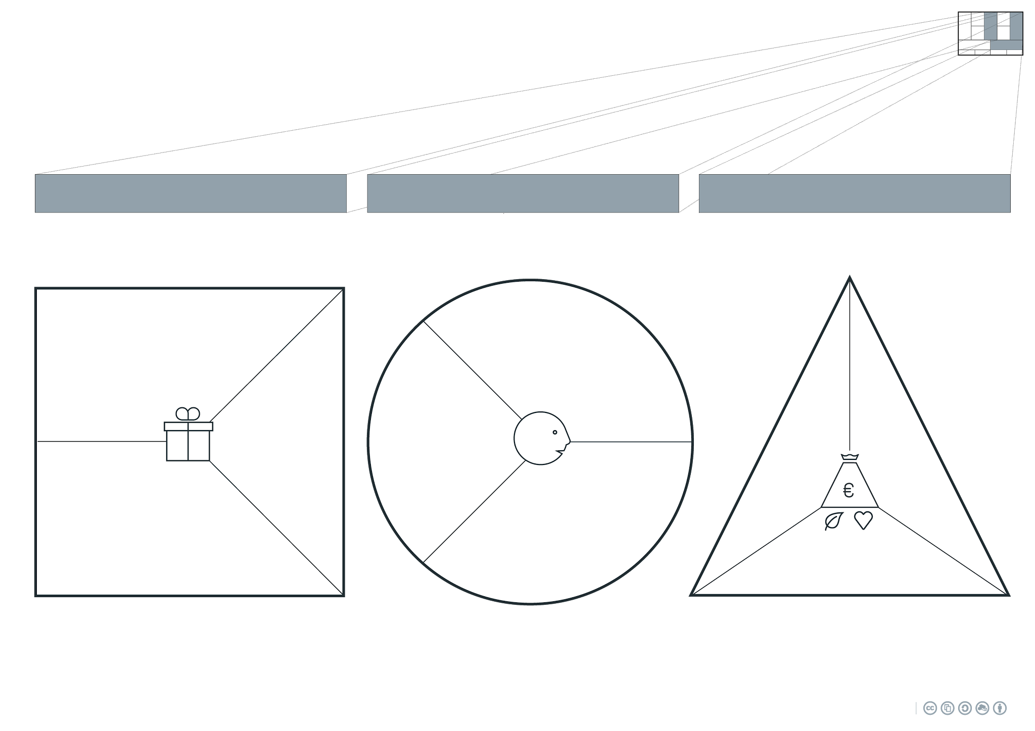
...
...
...
Applications:
...
...
⧠ Product
⧠ Service
⧠ Certification
⧠ Training
⧠ Maintenance
⧠ ...
...
...
...
...
...
...

Slide 2
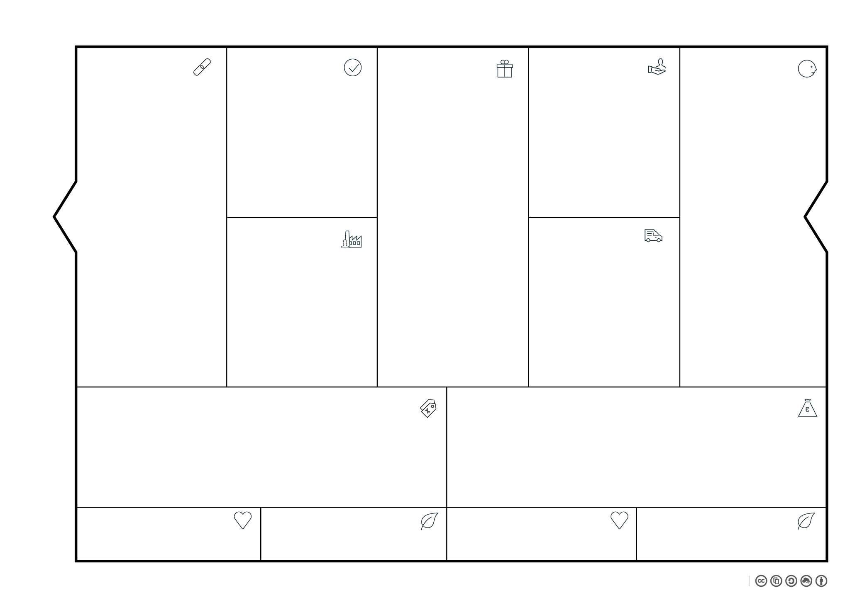

Slide 3
Materials | Transport | Production | Packaging | Sales
This BMC
Bas Sala, Production

